Slide 1
CAPSTONE PROJECT-4 NETFLIX MOVIES AND TV SHOW CLUSTERING
RISHI GUPTA
Data Science Trainee
Almabetter.

Slide 2
Problem Statement
This dataset consists of tv shows and movies available on Netflix as of 2019. The dataset is collected from Flixable which is a third-party Netflix search engine. In 2018, they released an interesting report which shows that the number of TV shows on Netflix has nearly tripled since 2010. The streaming service’s number of movies has decreased by more than 2,000 titles since 2010, while its number of TV shows has nearly tripled. It will be interesting to explore what all other insights can be obtained from the same dataset. Integrating this dataset with other external datasets such as IMDB ratings, rotten tomatoes can also provide many interesting findings.
In this project, we have done
● 1.Exploratory Data Analysis
● 2.Understanding what type content is available in different countries
● 3.Is Netflix increasingly focusing on TV rather than movies in recent years.
● 4.Clustering similar content by matching text-based feature

Slide 3
Data Description
The dataset consists of listings of all the movies and tv shows available on Netflix, along with details such as - cast, directors, ratings, release year, duration, etc.
Attribute Information
● show_id : Unique ID for every Movie / Tv Show
● type : Identifier - A Movie or TV Show
● title : Title of the Movie / Tv Show
● director : Director of the Movie
● cast : Actors involved in the movie / show
● country : Country where the movie / show was produced
● date_added : Date it was added on Netflix
● release_year : Actual Release Year of the movie / show
● rating : TV Rating of the movie / show
● duration : Total Duration - in minutes or number of seasons
● listed_in : Genre
● description: The Summary description

Slide 4
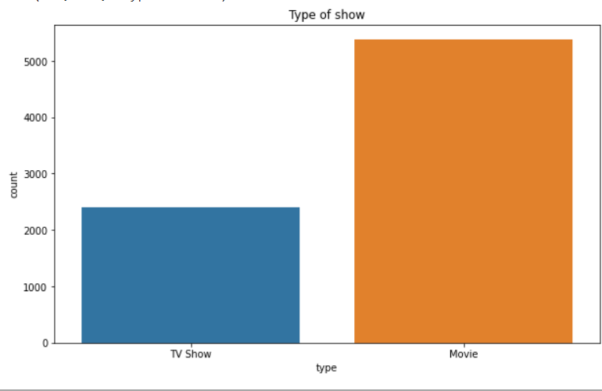
Exploratory Data Analysis
Type of show:
Netflix has 5372 movies and 2398 TV shows.
There are more movies on Netflix which is more than double the TV Shows.

Slide 5
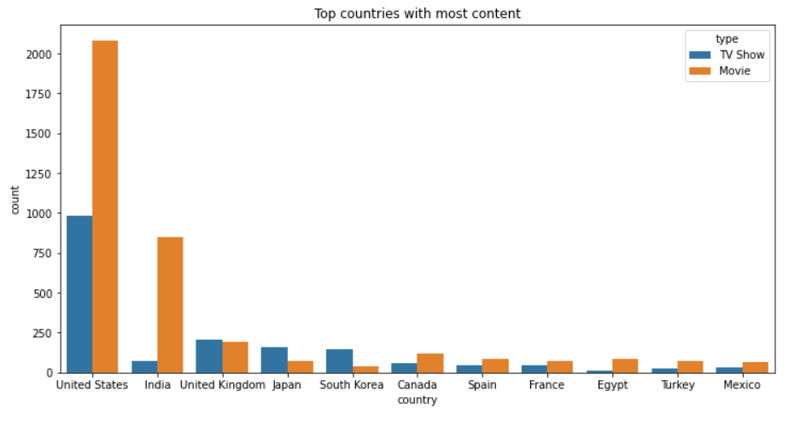
Countries with highest content.
U.S has highest content on Netflix followed by India and U.K

Slide 6
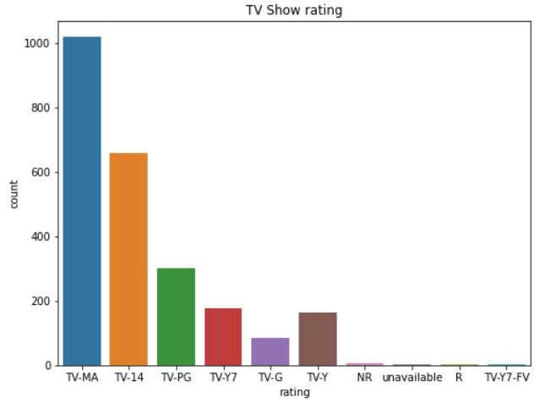
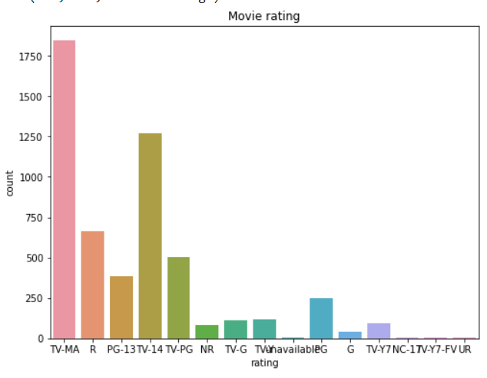
Ratings
● TV-MA has the highest number of ratings for tv shows .
● TV-MA has the highest number of ratings for movies .
● In both the cases TV-MA has the highest number of ratings.

Slide 7
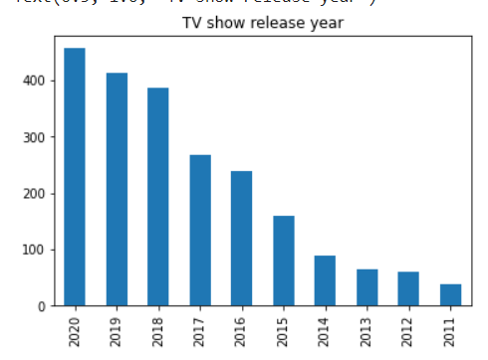
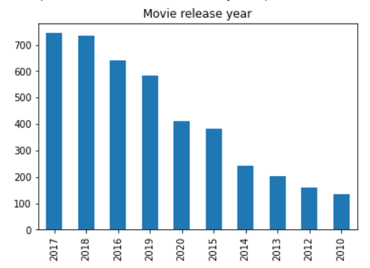
Release Year
● Highest number of movies released in 2017 and 2018
● Highest number of movies released in 2020
● We saw a huge increase in the number of movies and television episodes after 2015.
● It appears that Netflix has focused more attention on increasing Movie content that TV Shows. Movies have increased much more dramatically than TV shows.

Slide 8
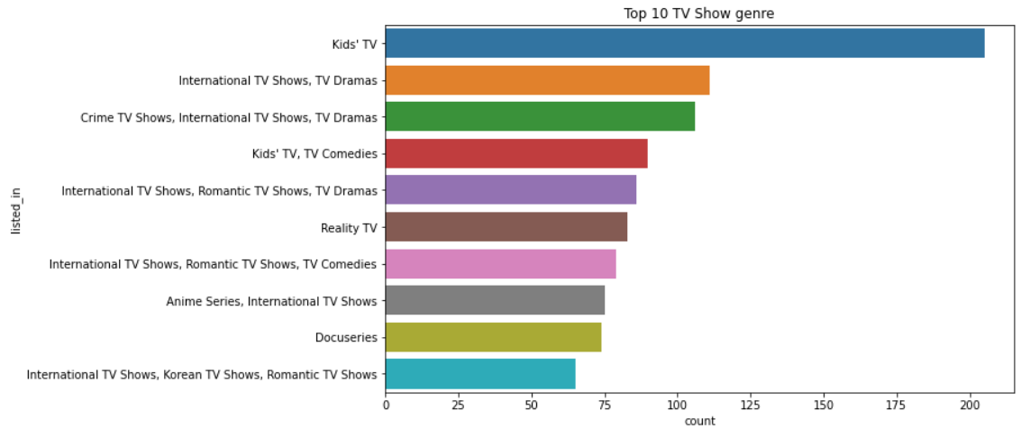
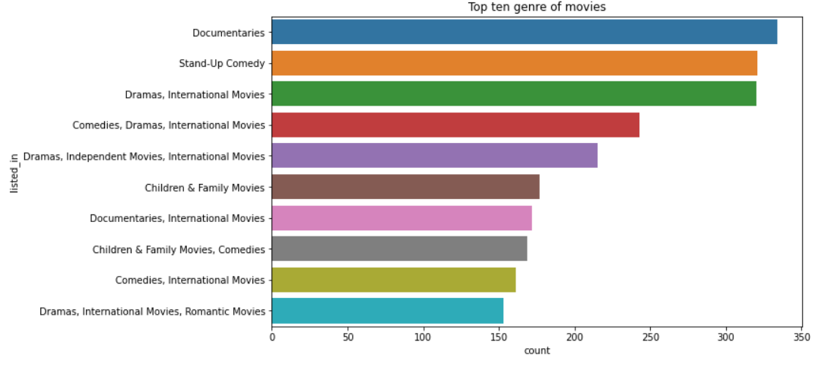
Genre
● Documentaries are the top most genre in Netflix which is followed by standup comedy and Drams and international movies.
● Kids tv show is the top most TV show genre in Netflix.

Slide 9
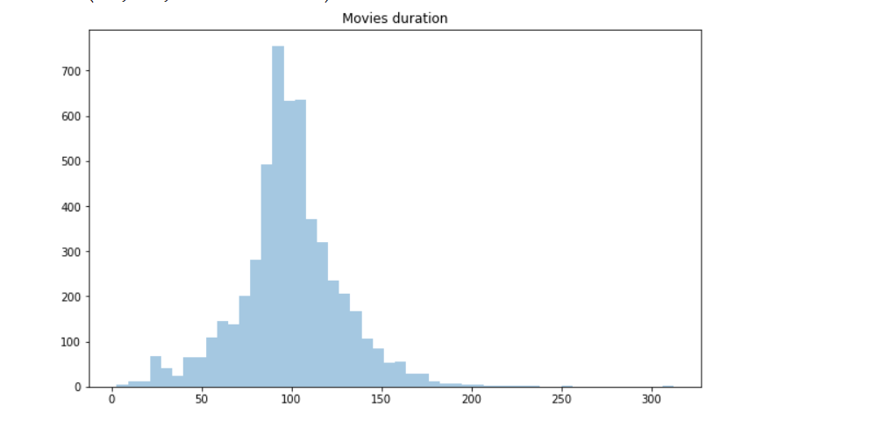
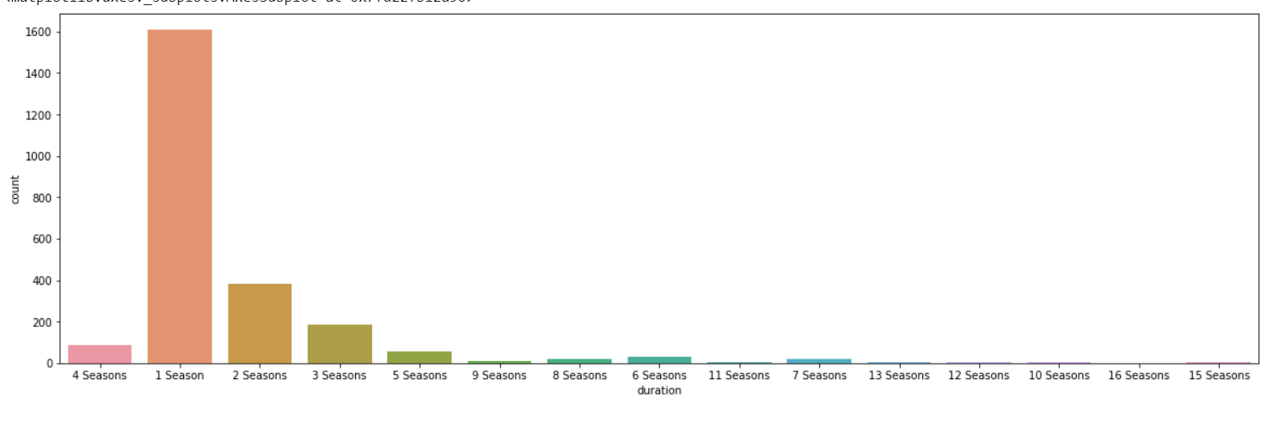
Duration
● Most of the movies have duration of between 50 to 150 minutes.
Most TV show have only one season.

Slide 10
Feature Selection
● Initially Separating the column type into movie and tv shows
● Here we are going to do Clustering similar content by matching text-based features so column description is one of the important feature
● Convert the text to lower case
● Tokenize the text
● Removed all the stop words and punctuation
● We use Term Frequency Inverse Document Frequency. This is very common algorithm to transform text into a meaningful representation of numbers which is used to fit machine algorithm for predictio

Slide 11
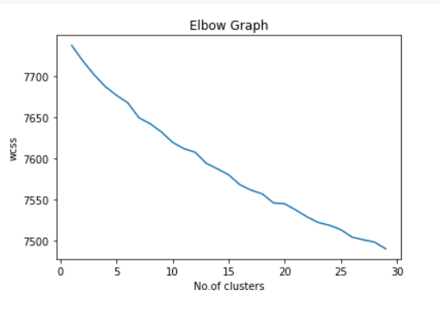
Applying K-Means clustering algorithm
K-Means Clustering is an Unsupervised Learning algorithm which groups the unlabeled dataset into different clusters. Here K defines the number of predefined clusters that need to be created in the process, as if K=2, there will be two clusters, and for K=3, there will be three clusters, and so on.
We use Elbow method to find out the optimal number of clusters.
From Elbow curve the optimal number of cluster comes out at 26.

Slide 12
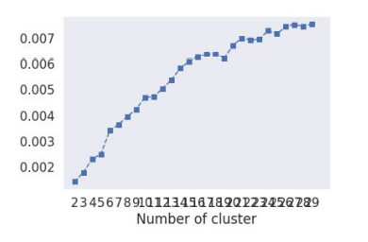
Evaluation
1.Silhouette Score : is a metric to evaluate the performance of clustering algorithm. It uses compactness of individual clusters(intra cluster distance) and separation amongst clusters (inter cluster distance) to measure an overall representative score of how well our clustering algorithm has performed
2.The Davies-Bouldin index (DBI ).It is most commonly used to evaluate the goodness of split by a K-Means clustering algorithm for a given number of clusters.
Silhouette score would always lie between -1 to 1. 1 representing better clustering
Silhouette score is 0.007499010681200968
Davies_bouldin_score is 9.05605194948868
So model is performing well

Slide 13
Agglomerative clustering
● In agglomerative clustering no need to give the value of k beforehand
● The agglomerative hierarchical clustering algorithm is a popular example of HCA
● Here we used ward linkage
● The optimal number of clusters is 4 using the Dendrogram

Slide 14
Evaluation
Silhouette Coefficient: -0.002
Davies_bouldin_score is 9.05605
Comparing with K mean only Davies_bouldin_score is better for hierarchical clustering Model.
Hence K-Means clustering is better performing model.

Slide 15
Conclusion
Netflix has 5372 movies and 2398 TV shows, there are more movies on Netflix than TV shows.
TV-MA has the highest number of ratings for tv shows i,e adult ratings
Highest number of movies released in 2017 and 2018 highest number of movies released in 2020 The number of movies on Netflix is growing significantly faster than the number of TV shows.
We saw a huge increase in the number of movies and television episodes after 2015.
It appears that Netflix has focused more attention on increasing Movie content than TV Shows. Movies have increased much more dramatically than TV show

Slide 16
.
Documentaries are the top most genre in netflix which is followed by standup comedy and Drama and international movies
Kids tv is the top most TV show genre in netflix
Most of the movies have duration of between 50 to 150
Highest number of tv_shows consisting of single season
United states has the highest number of content on the netflix followed by india and U.K.
For clustering we used K-Means clustering and Hierarchial clustering.
From elbow and sillhoute score ,optimal of 26 clusters formed , K Means is best for identification than Hierarchical as the evaluation metrics also indicates the same.

Slide 17
Thank You
.

